Slide 1


Slide 2

[Click the HP Logo to start Windows]

Slide 3


Admin
***********
Sign In

Slide 4











Recycle Bin
Word
Google Chrome
PowerPoint
Microsoft Outlook
Excel
OneNote
9:58am 11/30/2023

Slide 5





Search for something
Recycle Bin
Word
Google Chrome
PowerPoint
Microsoft Outlook
Excel
OneNote
Admin
9:58am 11/30/2023

Slide 6
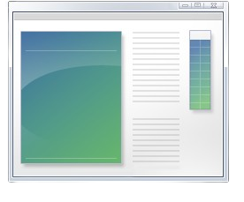
Winver ‎ ‎ ‎ ‎ ‎ ‎ ‎ ‎ ‎ ‎ ‎ ‎ ‎ ‎ ‎ ‎ ‎ ‎ ‎ ‎ ‎ ‎ ‎ ‎ ‎ ‎ ‎ ‎
Recycle Bin
Word
Winver
Google Chrome
PowerPoint
Microsoft Outlook
Excel
OneNote
Admin
9:58am 11/30/2023

Slide 7
X
Recycle Bin
Word
Windows Treetall Pro
Google Chrome
PowerPoint
This OS is not made by Microsoft, it’s just a Concept. Windows Treetall Pro is activated with a product key.
Licensed to: Admin
Microsoft Outlook
Excel
OneNote
OK
9:58am 11/30/2023

